Slide 1

SuStainStainableuse
The way you think determines your behaviour

Slide 2
COntent
01.
Introduction
02.
Analysis
03.
Our solution
04.
Assessment
A brief overview of energy consumption in Finland
Specific analysis of local household energy consumption in Finland
Diverse solutions that combine machine learning, data visualization platforms, and social action
Impact assessment

Slide 3
01.
introduction
A brief overview of energy consumption in Finland

Slide 4
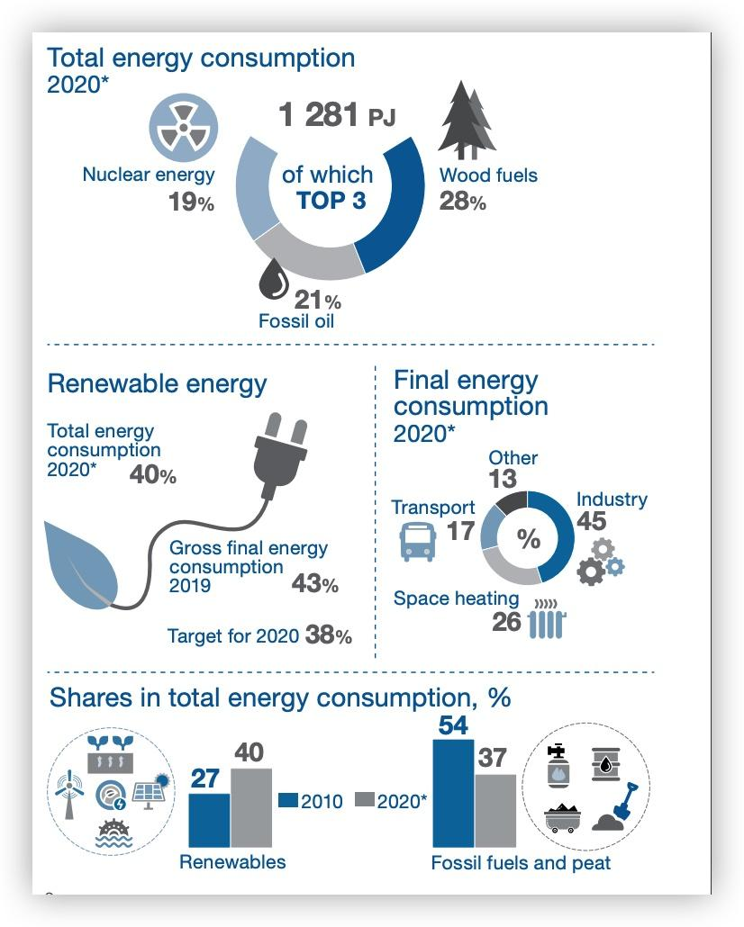
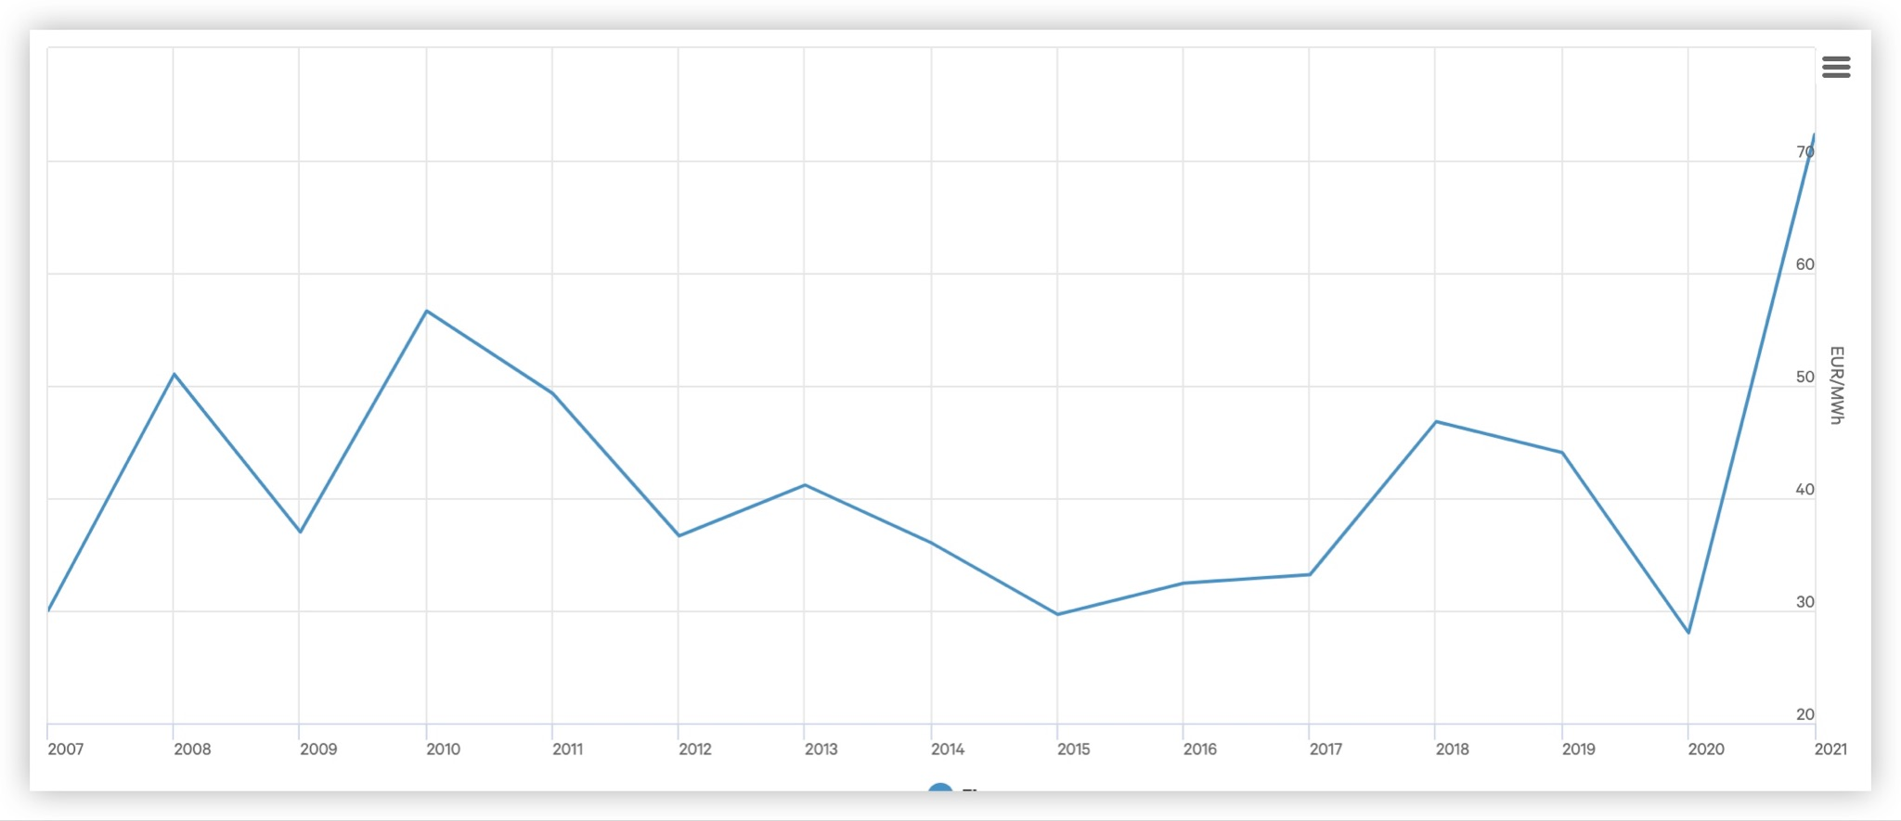
Energy Consumption in Finland
Trends in electricity consumption
Clear increase in total electricity consumption
Rising prices: The price of energy in Finland has reached record levels in 2021
Energy sources
Renewable: 40%
(27% in 2010)
Non-renewable: 37%
(54% in 2010)
Notes:
For decades, Finland has been shifting towards an increasingly energy-efficient society, with an emphasis on the use of sustainable and renewable energy resources. In the year 2020, up to 40% of Finland’s energy consumption was sourced from renewable resources, as compared to 37% in 2010 which suggests a 13% increase in just 10 years.
As for the trends in the general electricity consumption in Finland, the rate of consumption has been on the rise which may become increasingly challenging to sustain as the price rates continue to rise rapidly in the upcoming years.

Slide 5
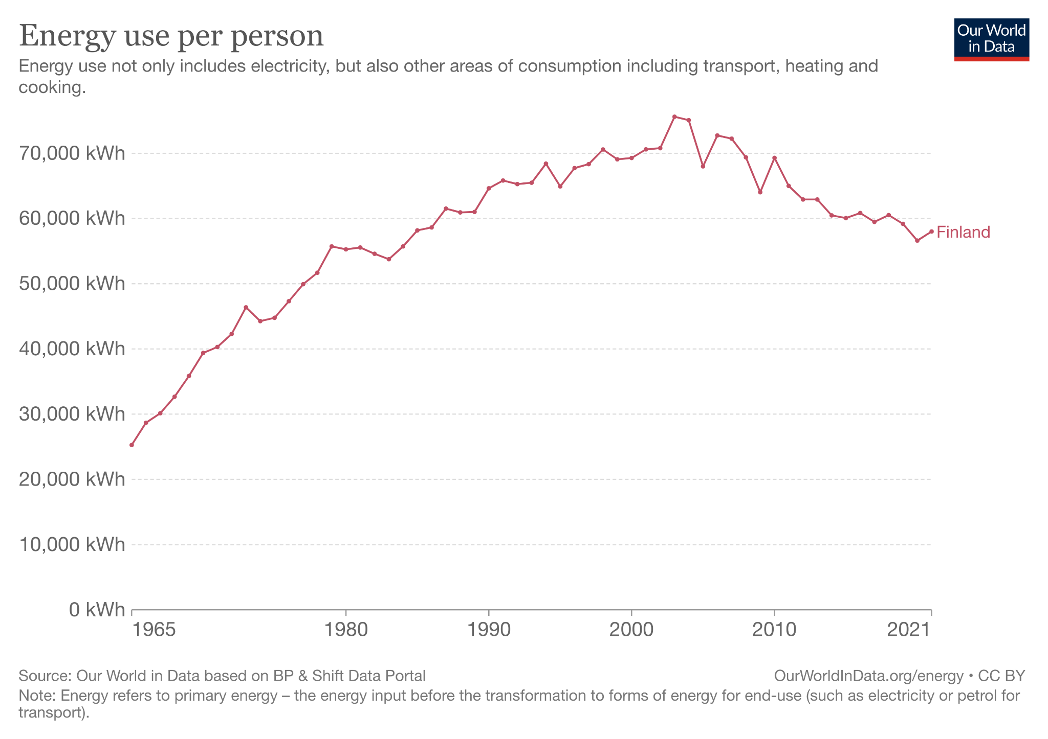
Energy Consumption per Person
According to our research:
Environmental values and energy saving in households are positively correlated
Environmental awareness and household energy savings are positively correlated
The way you think determines your behaviour!
Notes:
According to our research, there is a clear positive correlation between the consumers’ environmental values and their household energy savings. In addition, it has been found that environmental awareness as well as household savings also have a clear positive correlation with each other.
→ The graph needs to be changed

Slide 6
02.
Analysis
Specific analysis of local household energy consumption in Finland

Slide 7
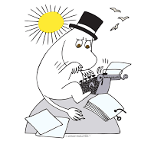
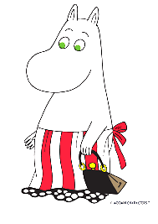


A Finnish FAMILY
Father
Mother
Works from home
Washes dishes late at night
Does three-shift work
Watches TV in the evenings
Brother
sister
Goes to school during the day
Plays video games in the afternoon
Lives away from home but visits every weekend
Notes:
The data used in our research contains real household electricity consumption data gathered from a private household in Finland. The data and figures presented showcase the daily electricity consumption of the family.

Slide 8
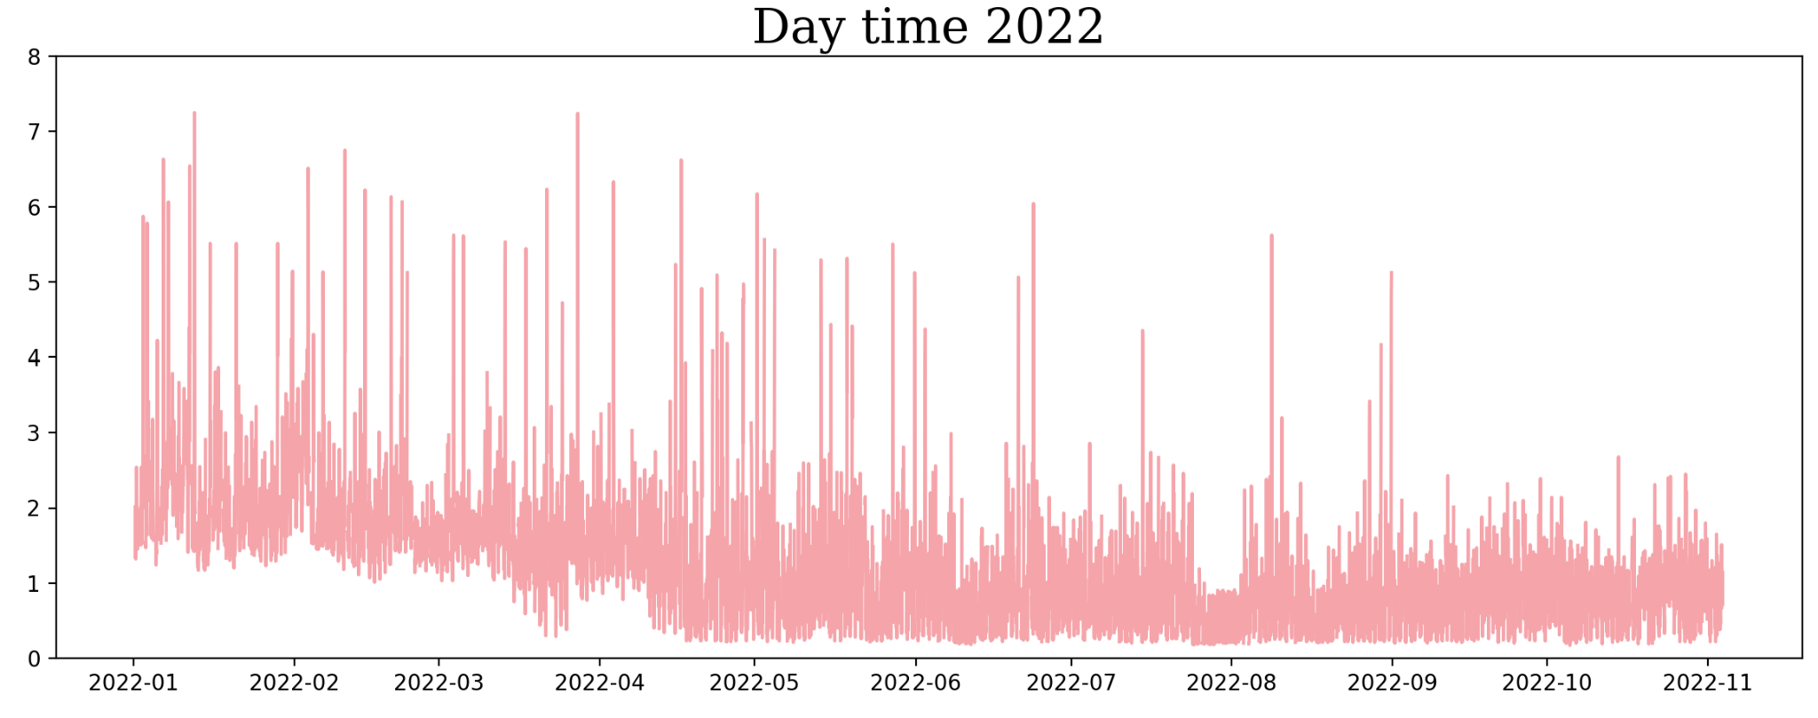
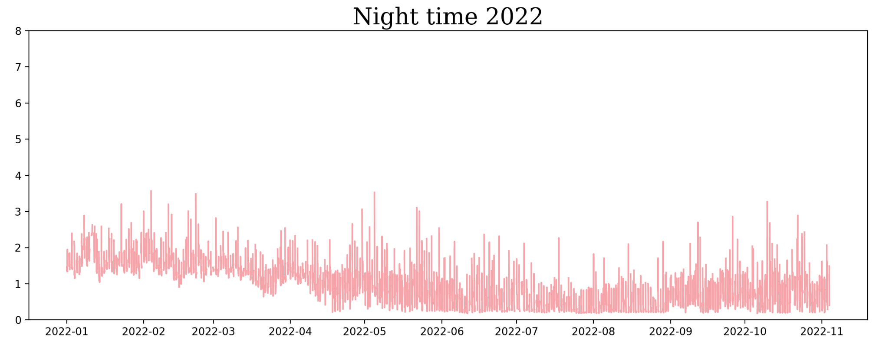
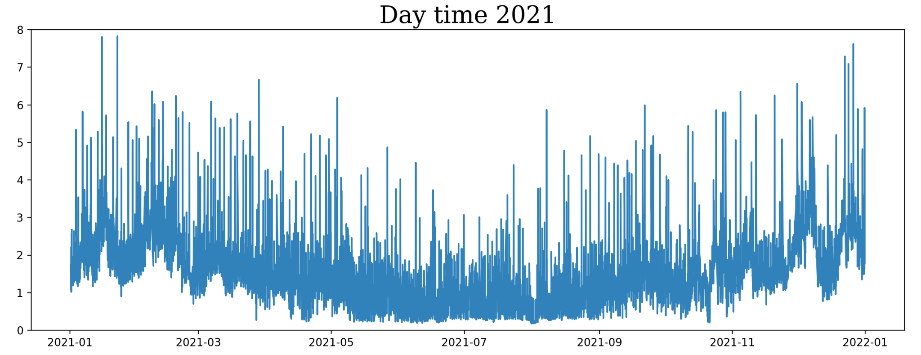
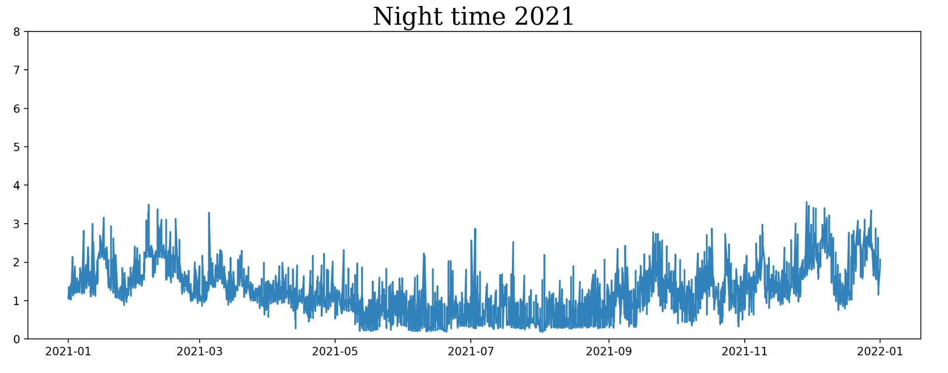
Yearly Energy consumption for the Finnish family
Jan - Nov 2022
Electricity
consumption (kWh) during the day and night
Jan - Dec 2021
Electricity
consumption (kWh) during the day and night
Notes:
The top two figures presented here showcase the differences between the daily and nightly electricity consumption for the entirety of the year 2021. Similarly, the bottom two graphs represent the differences between daily and nightly electricity consumption for the year 2022.
→this can be deleted if has to

Slide 9
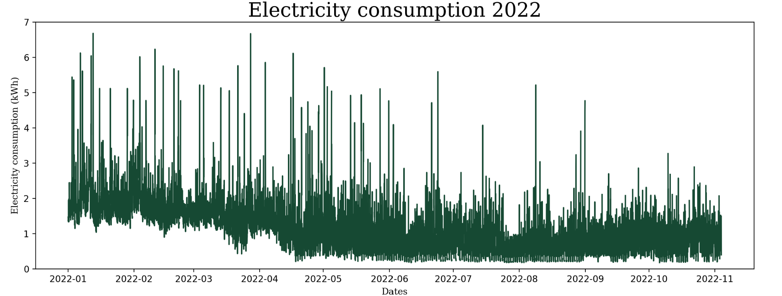
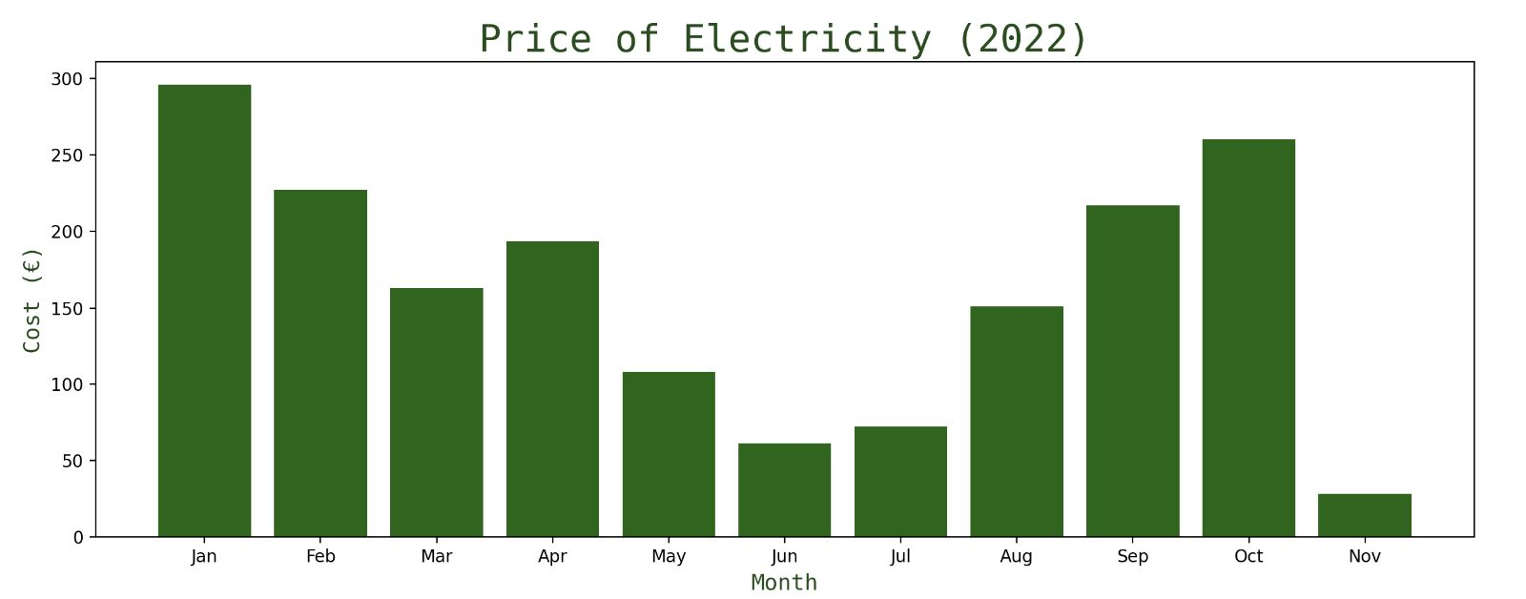
In this example,
Correlation between the price of electricity and consumption in 2022
Electricity price rises directly affect the figures
Notes:
In this example, we can see the correlation between the electricity price and electricity consumption in 2022. The critical fact here is that electricity price rises directly affected our graphs. As we can also see from September and October, the price is close to January and February even though the consumption is lower.

Slide 10
1. What is the value of data？
2. How to Motivate people to use the data?
QUESTIONs!

Slide 11
03.
Our solution
Diverse solutions that combine machine learning, data visualization platforms, and social action

Slide 12
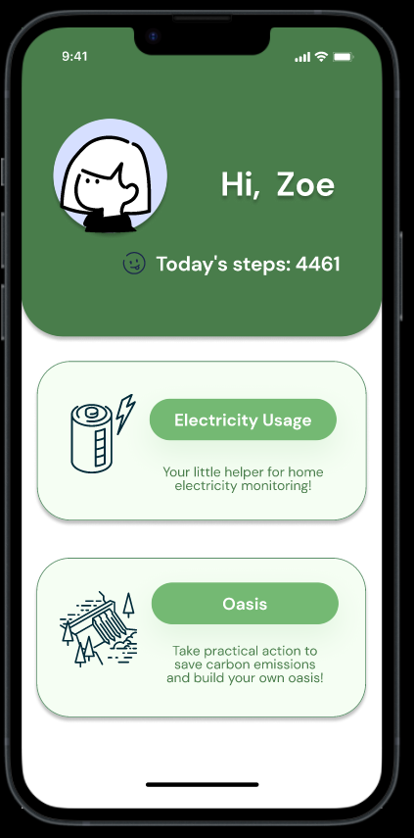
Data Visualization
Visualizing data allows users to see their electricity consumption habits easily
With features such as Oasis, the application aims to raise awareness about energy conservation
play
Notes:
Visualizing the data allows the users to see how much electricity is consumed at any given time. With the features such as Oasis, the application aims to raise awareness about energy conservation and enable users to be proactive and take adequate measures to save energy and reduce their carbon dioxide emissions ultimately. For example, they can calculate their carbon savings to gain energy which they can use that to grow a tree in the real world.

Slide 13
Consumption Prediction
Data
Collection
Data Cleaning
Construction
of Fourier model
Prediction
Obtain data by recording and collecting the daily power consumption
Data repair by processing missing data and eliminating crippled data
Dealing with duplicate data
Handle erroneous and unusable data to organize data format
Construct Fourier fit models from the data
Adjust fitting parameters to improve accuracy of the model
Predicting the future daily electricity consumption of the customer to allow easy comparison to current usage

Slide 14
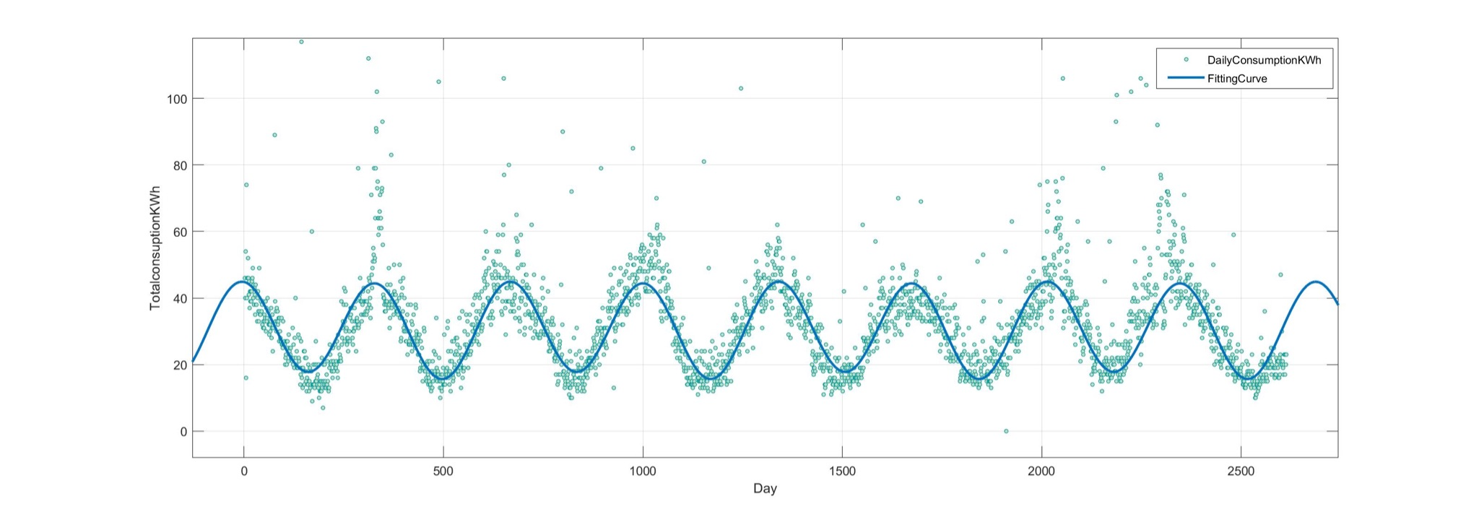
Fourier fit models
Data Content
Data includes daily electricity consumption of the household from
2015-2022
2. Goodness of fit:
SSE: 1.146e+04
R-square: 0.9869
Adjusted R-square: 0.9869
RMSE: 2.098
3. General model Fourier 2:
Coefficients (with 95% confidence bounds):
a0 = 30.69 (30.61, 30.77)
a1 = -0.04447 (-0.1613, 0.07237)
b1 = 1.1 (0.9875, 1.213)
a2 = 11.88 (11.76, 11.99)
b2 = 7.343 (7.23, 7.456)
w = 7.033 (7.029, 7.037)
Function:
f(x) = a0 + a1*cos(x*w) + b1*sin(x*w) + a2*cos(2*x*w) + b2*sin(2*x*w)
where x is normalized by mean 1309 and std 753.5

Slide 15

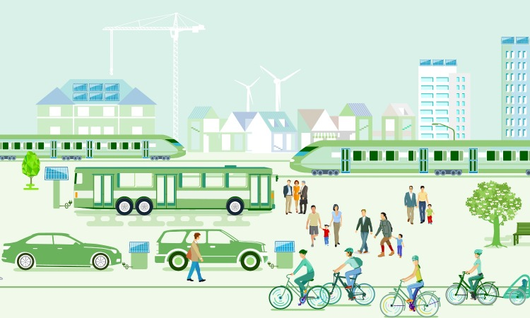


Social Movement
Food
Transportation
Company
People involvement
Increase the proportion of vegetarian food
Encourage people to increase the balance of vegetarian food in their daily meals
Reduce food waste
Use of sustainable transport
Promoting the marketization of public charging infrastructure for electric vehicles
Reducing port emissions
Employment status can moderate the link between work time and energy use
Spreading knowledge and increasing communication to promote a sustainable lifestyle
Notes:
develop weekly meal plans in advance to reduce the potential for food waste

Slide 16
04.
Assessment
Impact assessment

Slide 17


Impact Assessment
100%
95%
Data
Visualization
Predictive models with accuracy of 95%

Slide 18
Financial projections
800€- 1000€
1500€- 3000€
4000€-7000€
6300€-11000€
Visualization platform construction
Model construction and prediction
Social movement
Total

Slide 19
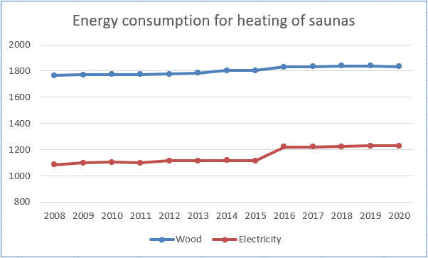
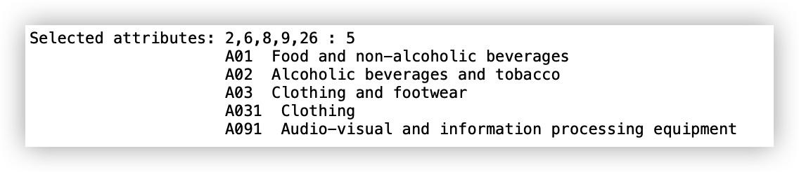
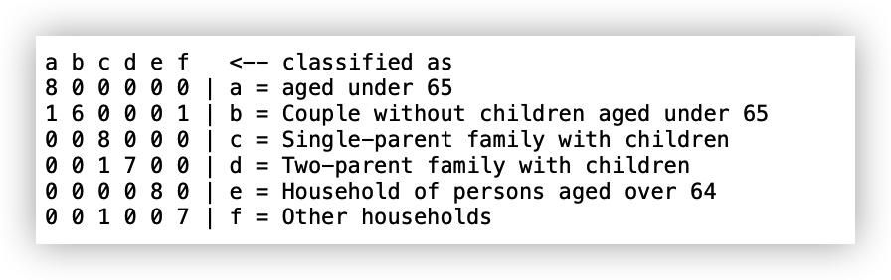
Interesting finding
Saunas
At a time of increasing energy shortage, Finnish people are still enthusiastic about saunas
attribute Selection
Feature extraction to find the main relevant factors that distinguish the consumption profiles of different household types

Slide 20
Thank YOU FOR LISTENING!

